Slide 2

OVERVIEW
OSS Maintenance + Management
Upgraded Health Checks
License Scanning
Dependency and Vulnerability Management
OSS Lab Workstream Report
Summary
Overview
Recommendations
Other Contributions
Helm + Deployment Fixes
Pool Party Updates

Slide 3
OSS Maintenance + Management

Slide 4
Let’s get Mojaloopy

Slide 5
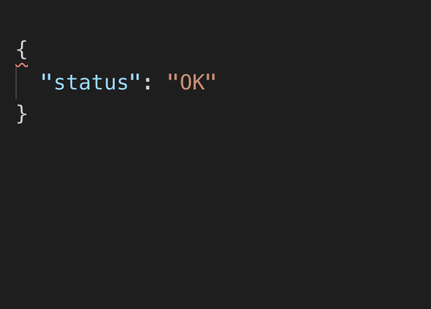
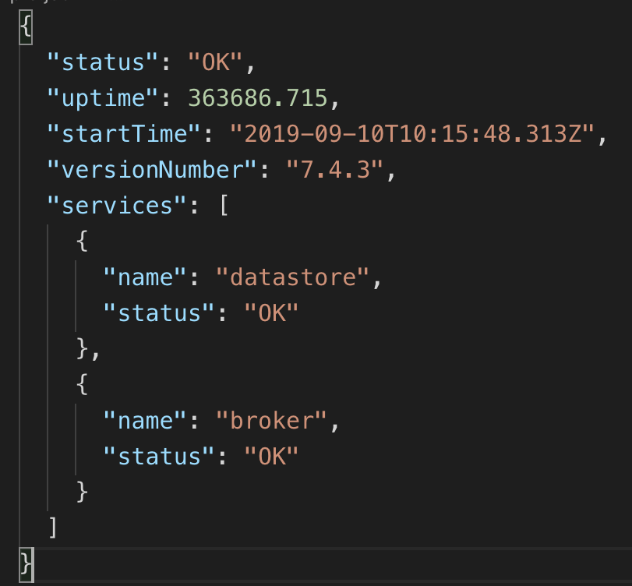
Health Checks
Improving health check reports for all core services
Will help make Kubernetes scheduler ‘smarter’
Also aids in developer and hub operator debugging and maintenance
BEFORE
AFTER

Slide 6
License-Scanning
Ensure we are free from viral licenses (e.g. GPL)
Making sure we stay free from viral licenses (integrated into the CI/CI Pipeline)
Allow us to run license scans across all repos at once
Maintain a blacklist of disallowed licenses

Slide 7
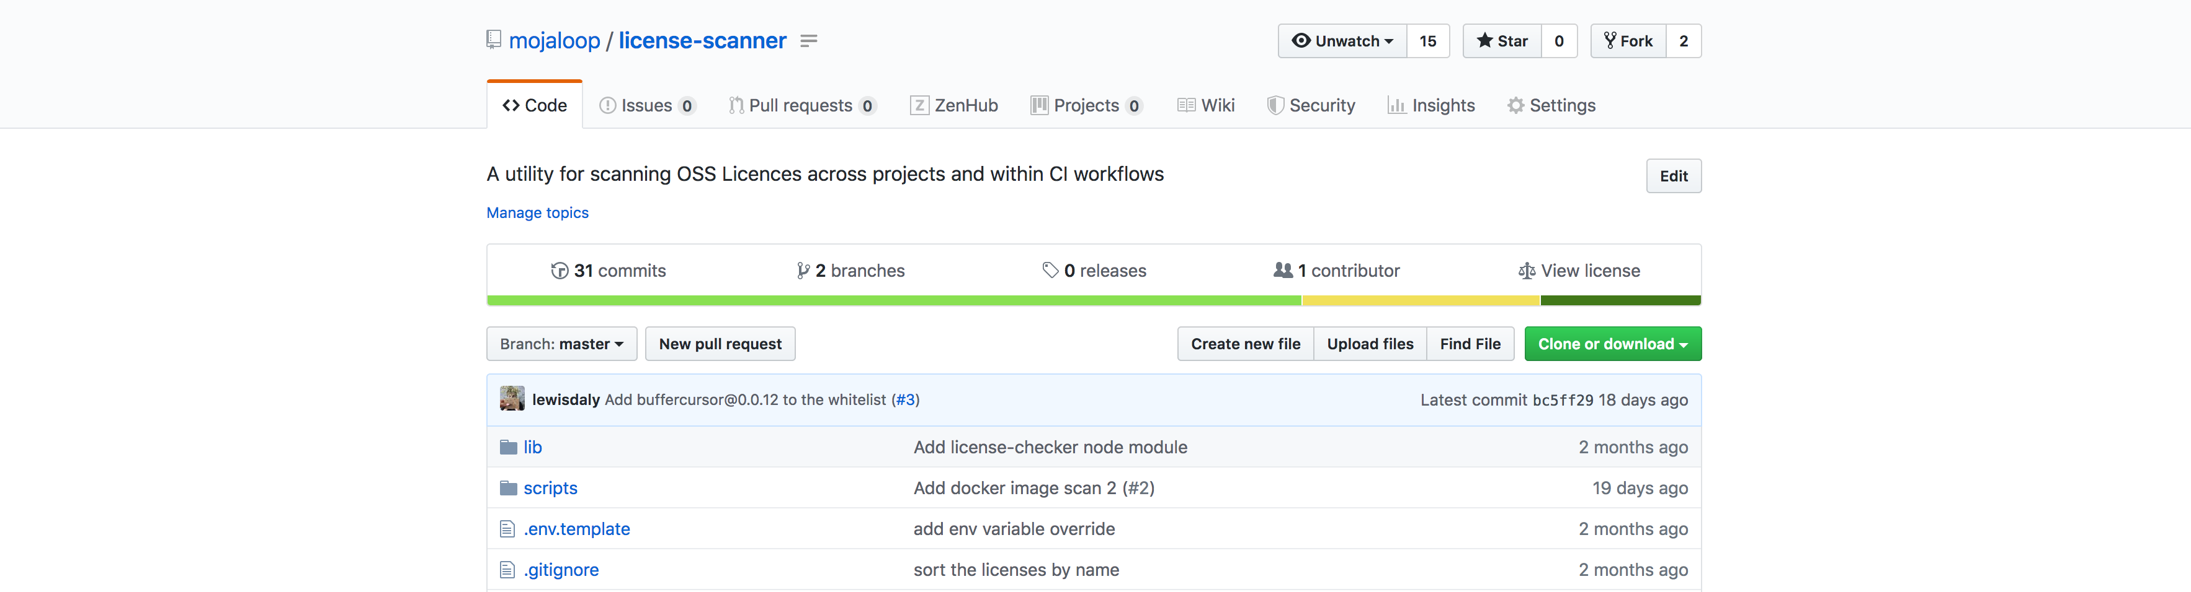
Introducing: License-Scanner
https://github.com/mojaloop/license-scanner

Slide 8
Introducing: License-Scanner
https://github.com/mojaloop/license-scanner
Maintains a blacklist of licenses and a whitelist of packages
CI Mode: Integrates with existing CI/CD Pipeline
Standalone: Runs against many repositories at once
Rules can be updated via Pull Request to the license-scanner repo

Slide 9
License-Scanning - CI/CD Process
In the CI/CD Pipeline, license scanner runs in 2 places:
During the PR approval build, against local node_modules
During a release, after docker build, against node_modules inside a docker image

Slide 10
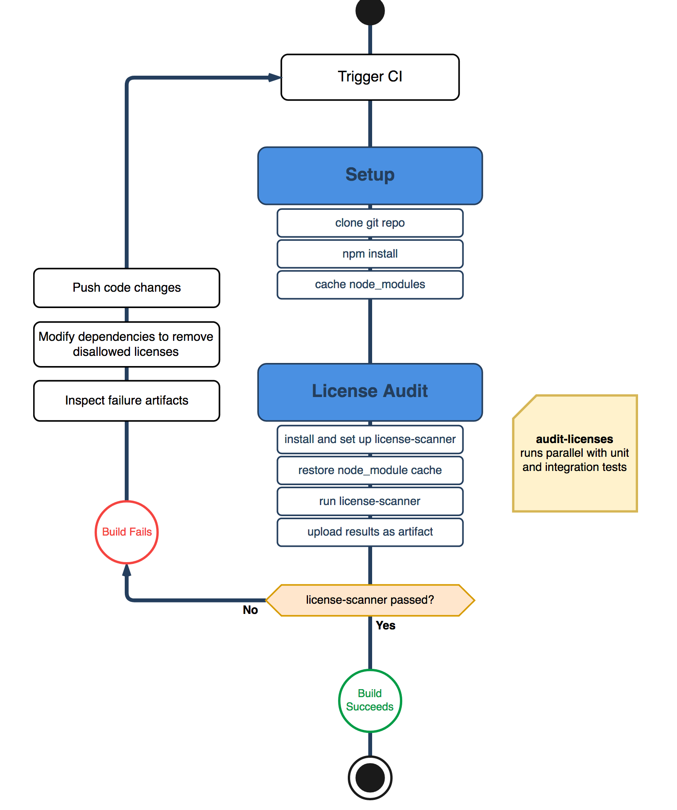
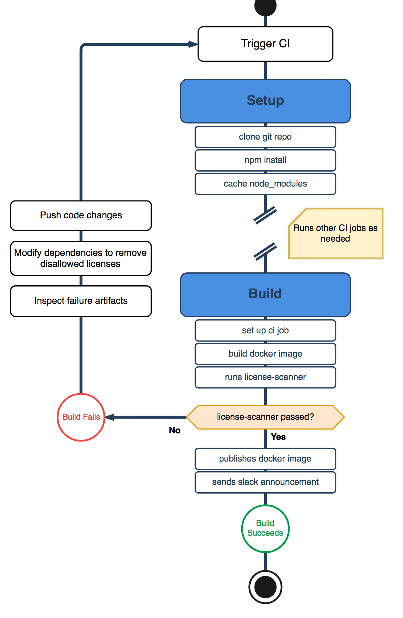
During PR:
During Release:

Slide 11
License-Scanning
Specify a list of github projects (must contain a package.json in the root directory)
$> make run
Produces a complied .xlsx file with a summary of licenses.
Red is a disallowed license, Yellow is a warning that the license was manually allowed

Slide 12
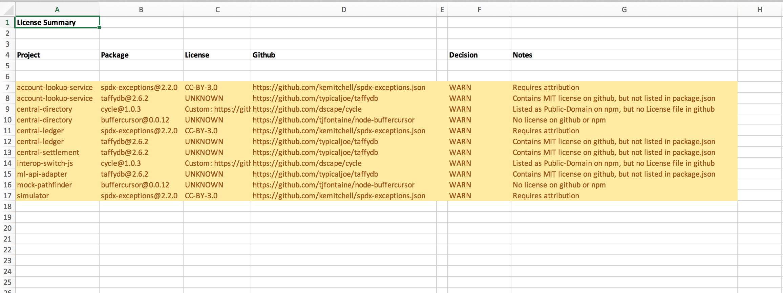
Example License Scan Summary

Slide 13



License-Scanning
Now integrated into our Helm release workflow
For every Helm release made, you will be able to download an Excel summary of all of the licenses

Slide 14
License-Scanning
But what to do about existing viral licenses?
Work on removing dependencies as we can.
Submit updates to packages and hope that maintainers will release new versions.
This has already been done… now we are just waiting.
As of now, there is no real method to replace or swap out dependencies in NodeJS

Slide 15
Dependency Management
In our package.json files, we are strict with locking down dependencies
This is great for producing reliable, reproduceable code, but can make it hard to stay up to date with dependencies
Dependabot does this for us
Github also has an integrated vulnerability checker which sends regular security alerts
We’ve also integrated npm’s native audit tool into our CI/CD pipeline.
If new vulnerabilities are found after committing code, it’s not going to be built!

Slide 16
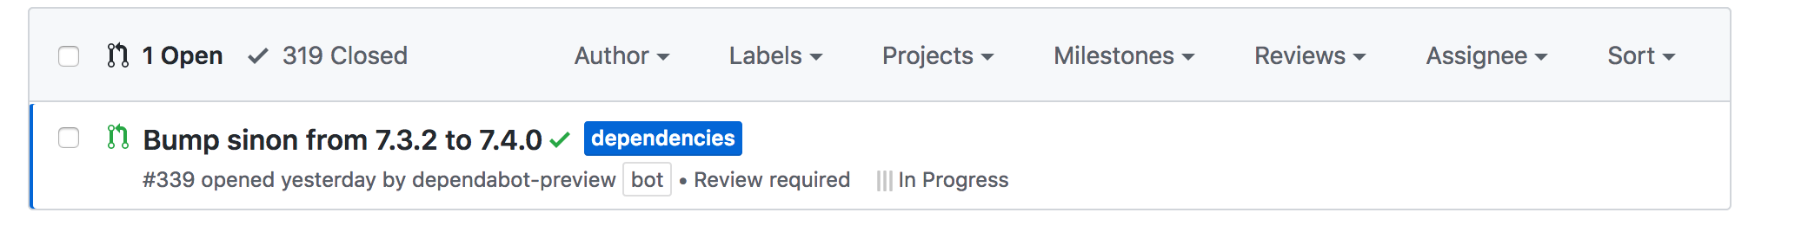
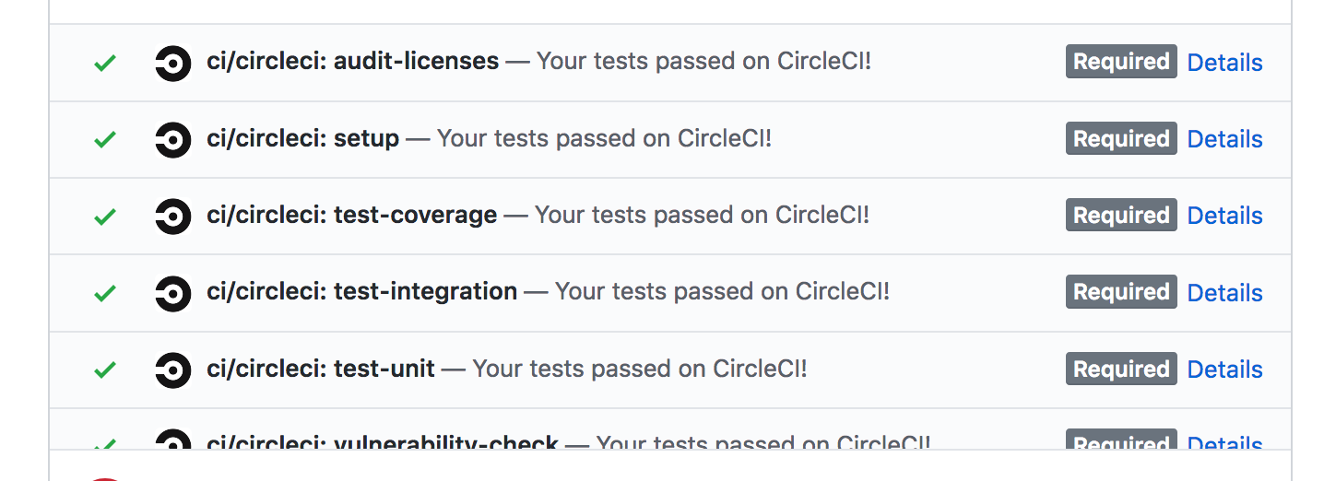
1. Automatically creates PRs when new packages are available
2. Triggers CI/CD Pipelines
3. Automatically Rebases when new commits are made to master

Slide 17
OSS Lab Investigation

Slide 18
It’s time to get Mojaloopy.

Slide 19
OSS Lab Investigation
Goal for PI7:
Investigate what an “OSS Lab” looks like, how it fits in with other efforts in the community, and determine what might be worth pursuing.

Slide 20
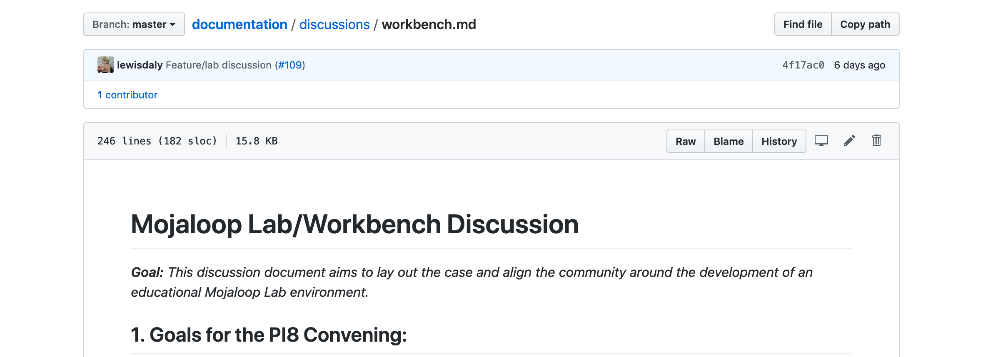
OSS Lab Investigation
Produced a discussion document available on Github:
https://bit.ly/2mauhB5
https://github.com/mojaloop/documentation/blob/master/discussions/workbench.md

Slide 21
OSS Lab Investigation - Nomenclature
Tool
A device used to carry out a function
Different tools for different functions: You wouldn't use a screwdriver to drive a nail.
In a Mojaloop context, one example of a tool is the Bank Oracle
Workbench
Combines different tools together in one place
For example, a hand plane, table saw and chisel can make up a woodworking workbench, while a hacksaw, file and angle grinder can make up a metalworking workbench
In the Mojaloop parlance, tools to test my DFSP's JWS keys are in a different workbench than tools that demonstrate to a fintech how wholesale APIs can work on top of Mojaloop

Slide 22
OSS Lab Investigation - Nomenclature
Lab
A lab is a place you go to run experiments
We run experiments in order to learn, and test our assumptions
A single lab combines multiple workbenches together in one place
Simulator
A tool that simplifies or abstracts away some function so you can test one thing at a time
Pilots train with simulators before flying a real life, dangerous and expensive plane.
Within Mojaloop: a simulator can simulate interacting with some component of the system

Slide 23
OSS Lab Investigation – Assumptions
Many of these go without saying… but let’s say them regardless.
The Gates Foundation wants to encourage adoption for Mojaloop at all levels (not just the ‘big fish’)
We don't need a lab environment to serve the needs of a Switch deployment or implementing DFSP - these needs will be met elsewhere
The Mojaloop OSS Community wants to make itself attractive to all

Slide 24
OSS Lab Investigation – Primary users
DFSPs needing to integrate with Mojaloop: (shorthand: Implementing DFSP)
Organisations/Individuals wishing to learn about Mojaloop and wanting to build and test functionality or use cases as a DFSP (shorthand: Evaluating DFSP)
Organisations/Individuals wishing to learn about Mojaloop and wanting to build and test functionality or use cases as a Hub Operator (shorthand: Evaluating Hub Operators)
Regulators, Organisations or Individuals wishing to understand and evaluate Mojaloop and how it might impact their existing service (shorthand: General Evaluators)

Slide 25
OSS Lab Investigation – Secondary users
Systems Integrators wishing to offer Mojaloop as a Service or pieces of Mojaloop integration as a Service (Systems integrator)
Individual Contributors (including bug bounty hunters?) (Individual Contributor)
Fintechs operating on top of or who will operate on top of a mojaloop-enabled switch (Mojaloop-powered fintech)
3rd Party App Provider interacting with wholesale mobile money APIs, selling integrations to fintechs and the like (3rd party app provider)
Financial Advocates, who are interested in promoting Mojaloop and other technologies that help drive financial inclusion (Financial Inclusion Advocates)

Slide 26
OSS Lab Investigation – Use Cases
Test a Mojaloop compatible DFSP implementation
Validate assumptions about Mojaloop
View and use a reference implementation
Learn about Mojaloop internals
Learn about Mojaloop-enabled switches and associated use cases (technology)
Assess how Mojaloop will change fintech business landscape
Be able to demonstrate a value proposition for DFSPs/Fintechs/etc. to use mojaloop (instead of technology _x_)

Slide 27
Use Case Matrix
 | a. Test DFSP Impl | b. Validate Assumptions | c. Reference Impl | d. Learn Internals | e. Learn about Tech | f. Evaluate Business Cases | g. Demonstrate ML Value
User:
1. Implementing DFSP | X |  | X
2. Evalutating DFSP |  | X | X |  | X | X
3. Evaluating Hub Operator |  |  | X |  | X | X
4. General Evaluator |  |  |  |  | X | X
5. Systems Integrator | X | X | X | X |  |  | X
6. Individual Contributor |  | X | X | X
7. Mojaloop-powered fintech |  | X |  |  | X | X | X
8. 3rd Party App Provider |  |  |  | X |  |  | X
9. Financial Inclusion Advocates |  | X |  |  |  | X | X

Slide 28


Use Case Matrix
 | a. Test DFSP Impl | b. Validate Assumptions | c. Reference Impl | d. Learn Internals | e. Learn about Tech | f. Evaluate Business Cases | g. Demonstrate ML Value
User:
1. Implementing DFSP | X |  | X
2. Evalutating DFSP |  | X | X |  | X | X
3. Evaluating Hub Operator |  |  | X |  | X | X
4. General Evaluator |  |  |  |  | X | X
5. Systems Integrator | X | X | X | X |  |  | X
6. Individual Contributor |  | X | X | X
7. Mojaloop-powered fintech |  | X |  |  | X | X | X
8. 3rd Party App Provider |  |  |  | X |  |  | X
9. Financial Inclusion Advocates |  | X |  |  |  | X | X

Slide 29
Let’s Dive a Little Deeper…

Slide 30
Use Case Deep Dive – Evaluating DFSP
Evaluating DFSP: Organizations/Individuals wishing to learn about Mojaloop and wanting to build and test functionality or use cases as a DFSP
Use Cases:
- Validate assumptions about Mojaloop
- View and play with a reference implementation
- Learn about mojaloop-enabled hubs and associated use cases (technology perspective)
- Assess how Mojaloop will affect their business in the future
Outputs:
- help to onboard to the Mojaloop ecosystem
- help to understand the technology, where it works well, and the potential pitfalls/drawbacks
- minimize investment in getting things working so they can focus on building out use case prototypes
- take them from little to no understanding of Mojaloop -> demonstrating real prototypes
Inputs:
- Improved Mojaloop documentation specific for this role.
- Think about and design the documentation and onboarding flow specifically for *Evaluating DFSPs*
- Documentation should be approachable by product manager etc. with little technical knowledge
- Technical deep dive on the technology behind Mojaloop, why, how it works
- Improved guides for up and running on 2-3 major kubernetes providers, self service and install scripts
- Helm charts for 1-2 simulators/labs that can be spun up alongside a switch, with opinionated pre-configured settings

Slide 31
Use Case Deep Dive – Mojaloop Powered Fintech
Mojaloop Powered Fintech: Fintechs operating on top of or who will operate on top of a Mojaloop-enabled switch
Use Cases:
- Validate assumptions about Mojaloop (how it works, what it does, what it doesn't do)
- Learn how Mojaloop is aligned with wholesale APIs, and what it would take to get a DFSP using these APIs over a Mojaloop switch
- Learn about Mojaloop enabled hubs and associated use cases (technology perspective)
- Assess how Mojaloop will affect their business in the future
Outputs:
- Understand how Mojaloop and Wholesale APIs fit together (or don't)
- Enable Fintechs to interact with Mojaloop over 1 or 2 wholesale banking APIs (e.g. GSMA MM API)
- take them from little to no understanding of Mojaloop -> demonstrating real prototypes
Inputs:
- Improved Mojaloop documentation specific for this role.
- Documentation or working document on how Mojaloop will work with wholesale APIs
- Self-deployed lab environment with DFSP that expose some wholesale APIs with basic functionality for Fintechs to test against

Slide 32
OSS Lab Investigation – Other Efforts
I won’t cover this all here, but it’s important to keep in mind…
Mifos
Extensive progress in this area with Fineract
Working on Open API integrations
Have an existing Lab deployment with Mojaloop that is currently being upgraded to work with the latest Helm chart deployments
GSMA
GSMA Mobile Money API – want to see end to end prototypes talking over Mojaloop switch
GSMA Lab covers a wide scope, Mojaloop is one piece
Interested in seeing how GSMA can add the most value to Mojaloop

Slide 33
OSS Lab Investigation – Other Efforts
I won’t cover this all here, but it’s important to keep in mind…
ModusBox
Open sourced SDK and Scheme Adapter (building blocks for building lab environments quickly)
Want to be able to show ‘how the engine works’ and build confidence for non-technical stakeholders
Interested in Mojaloop Lab as a place for fintechs to learn and test concepts on top of Mojaloop
How can we assist orgs. With little-to-no technical capacity to become confident with Mojaloop?

Slide 34
OSS Lab Investigation – Our Recommendations
I won’t cover this all here, but it’s important to keep in mind…
Find a target user that we can build a lab for/with
- Perhaps one of the more serious hackathon teams?
Address and improve documentation gaps: driving from a role-specific perspective
Mojaloop over Spreadsheet Demo
Build a self-service lab prototype
Opinionated set of helm charts that can be deployed alongside general switch
Gather feedback from the community, and see where and how people are using it (or not)

Slide 35
Other Contributions

Slide 36
Other Contributions
Active in OSS Community meetings
Design Authority Participation
Misc. bug fixes and improvements
Helm and Deployment fixes
Improving the local development environment with docker-compose
Pool Party
Was planned for Sprint 5
Ended up going to the beach…

Slide 37

Other Contributions

Slide 38

MOJA
Brand Deal Idea?

Slide 39
Thanks!
Any Questions?
lewisd@crosslaketech.com
…or hit me up on Slack

